Slide 1
Unions in C
A union is a special data type available in C that allows to store different data types in the same memory location.
You can define a union with many members, but only one member can contain a value at any given time.
Unions provide an efficient way of using the same memory location for multiple purpose.
All the members of a union share the same memory location.
Therefore, if we need to use the same memory location for two or more members, then union is the best data type for that.
The largest union member defines the size of the union.

Slide 2
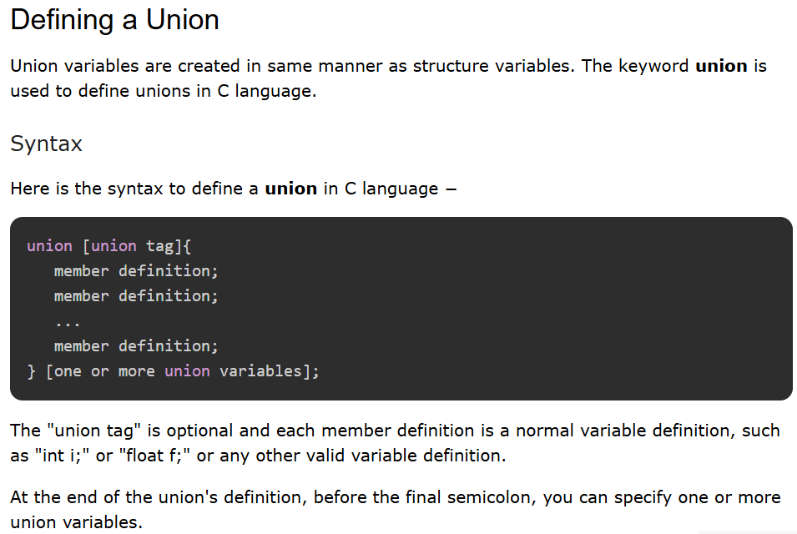

Slide 3
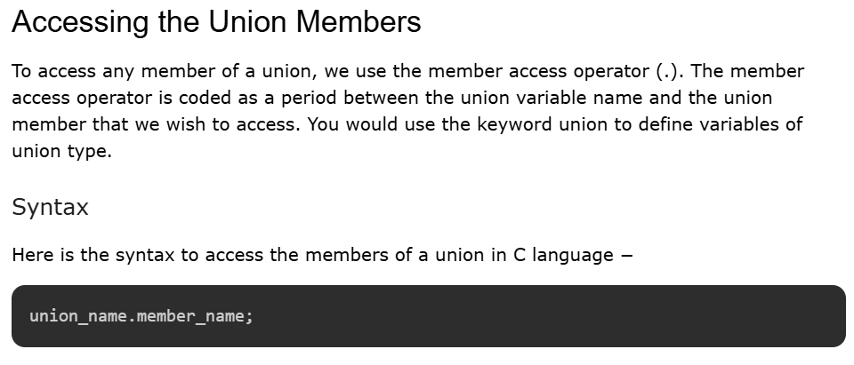

Slide 4
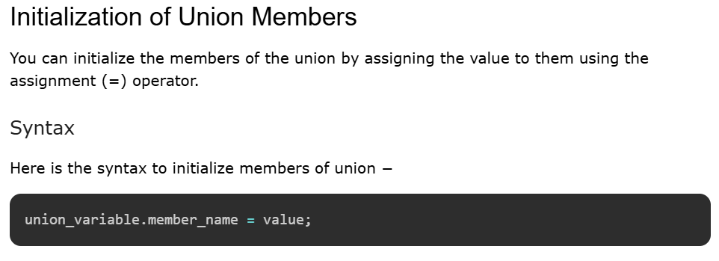

Slide 5
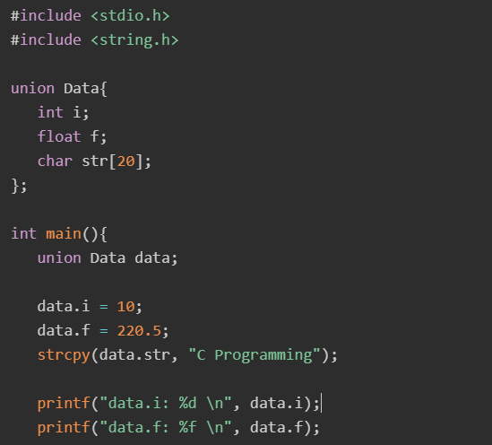
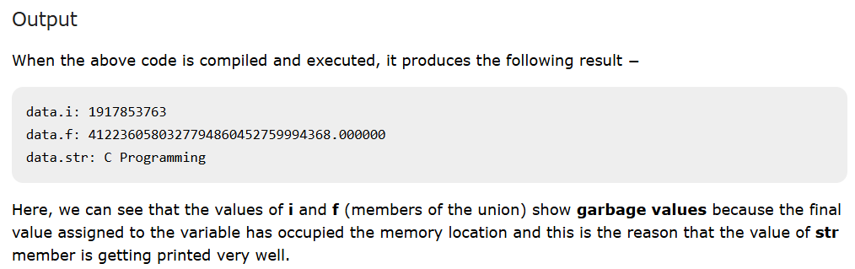


Slide 6
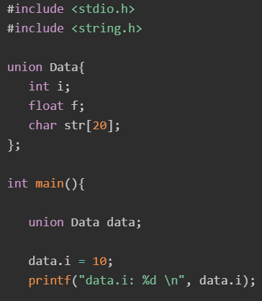
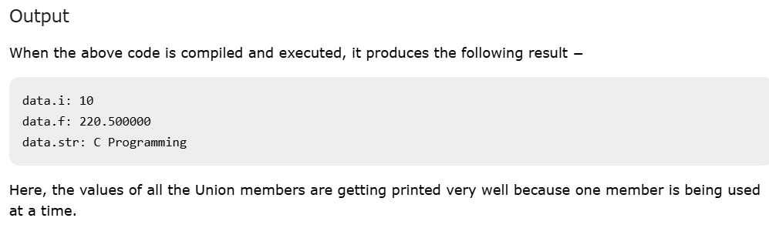
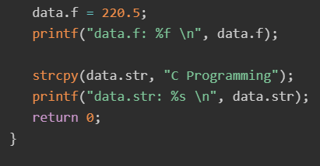

Slide 7
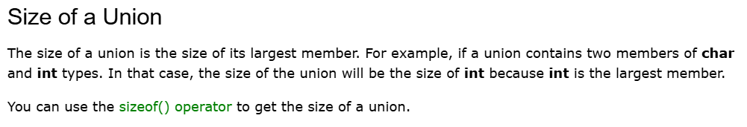

Slide 8
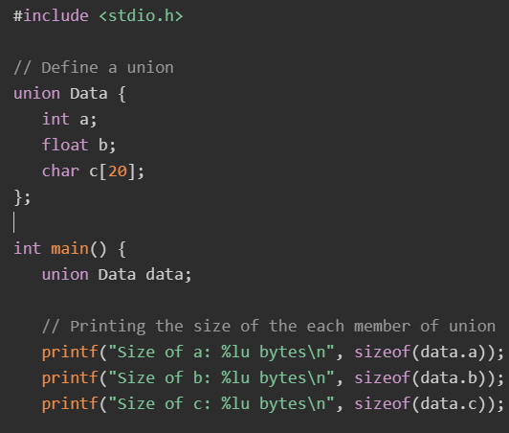
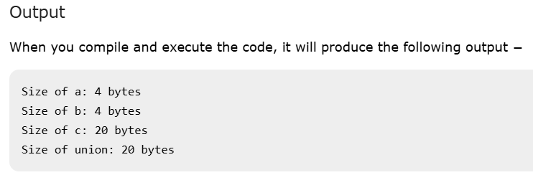
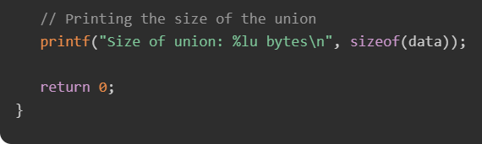

Slide 9
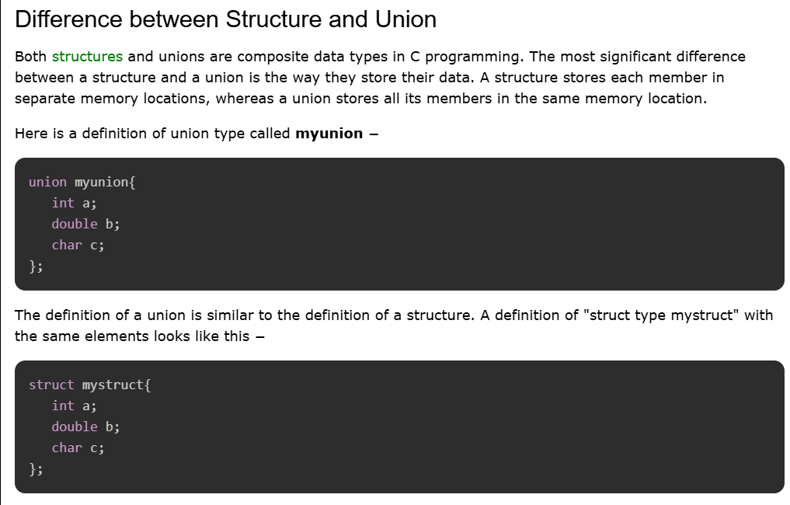

Slide 10
The main difference between a struct and a union is the size of the variables.
The compiler allocates the memory to a struct variable, to be able to store the values for all the elements.
In mystruct, there are three elements − an int, a double, and char, requiring 13 bytes (4 + 8 + 1). Hence, sizeof(struct mystruct) returns 13.
On the other hand, for a union type variable, the compiler allocates a chunk of memory of the size enough to accommodate the element of the largest byte size.
The myunion type has an int, a double and a char element. Out of the three elements, the size of the double variable is the largest, i.e., 8.
Hence, sizeof(union myunion) returns 8.
Another point to take into consideration is that a union variable can hold the value of only one its elements.
When you assign value to one element, the other elements are undefined.
If you try to use the other elements, it will result in some garbage.

Slide 11
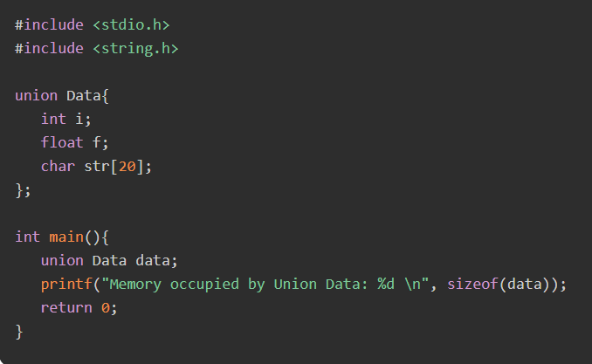
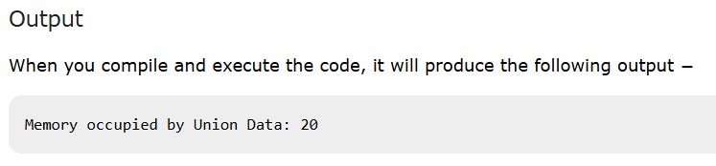

Slide 12


